Slide 1
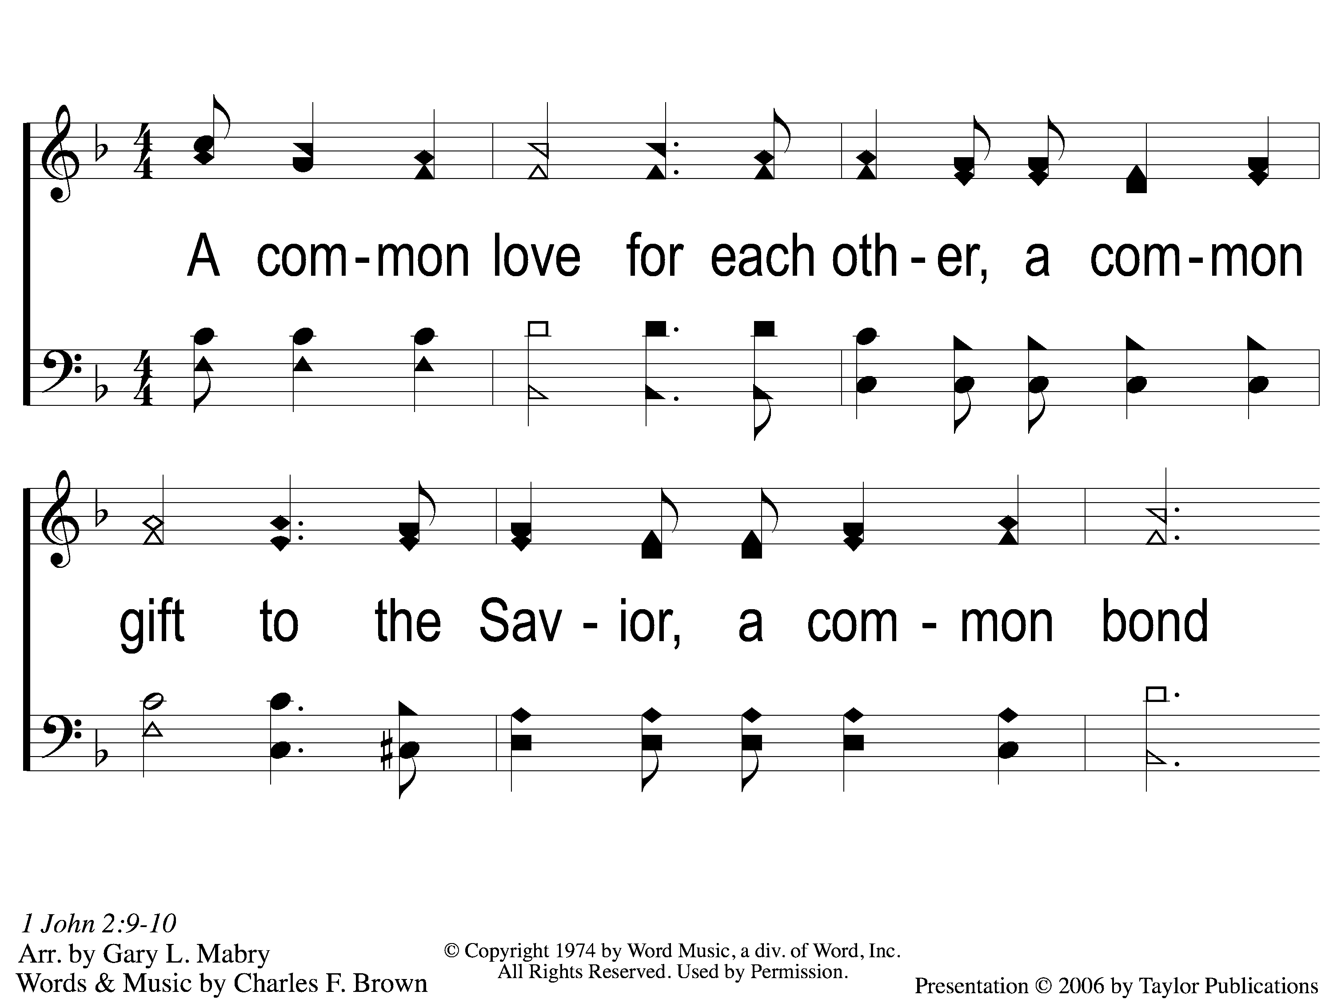
1 A Common Love
A Common Love
705

Slide 2
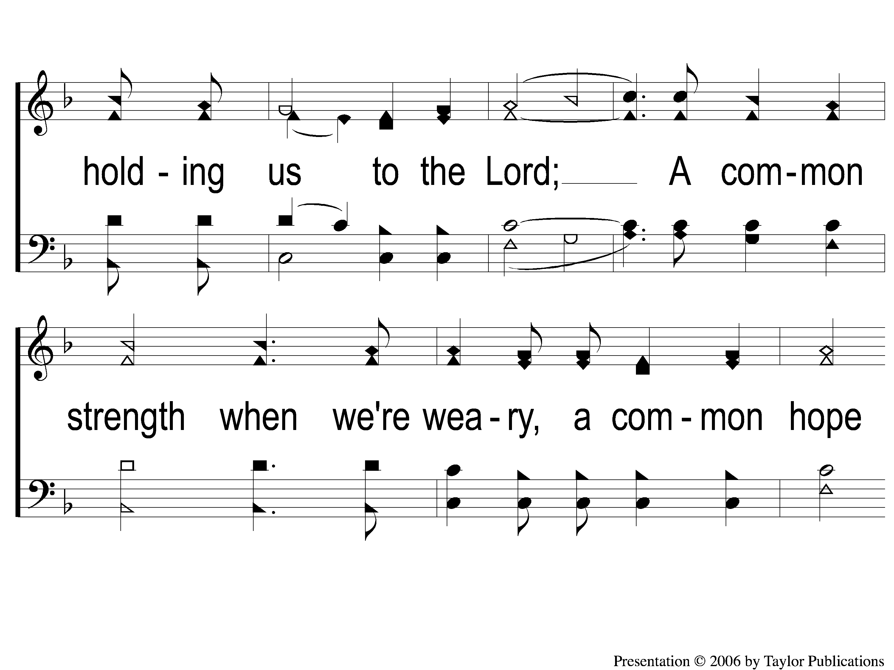
2 A Common Love
A Common Love
705

Slide 3
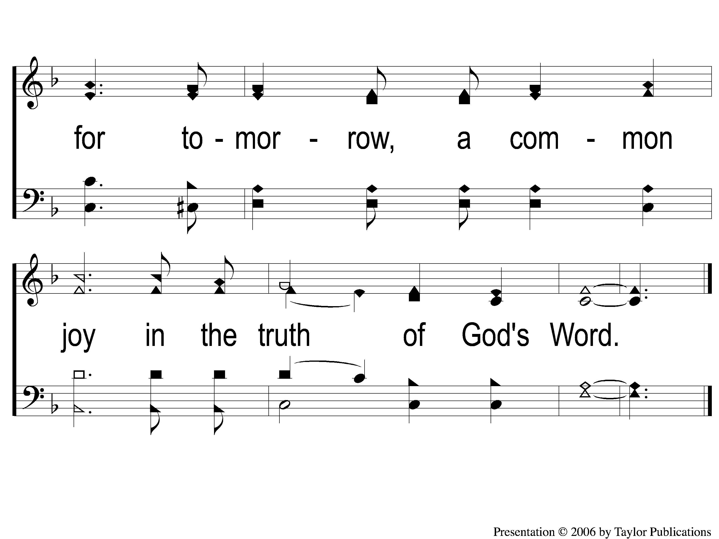
3 A Common Love
A Common Love
705

Slide 4
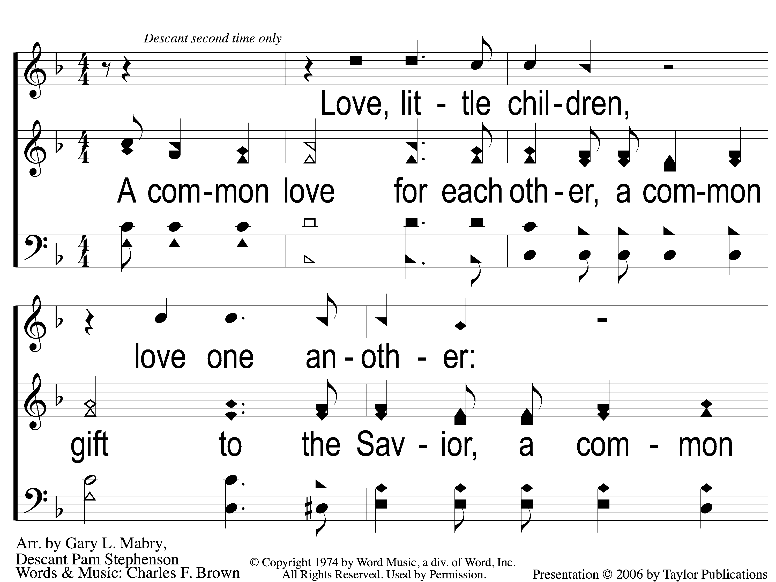
1 Opt descant A Common Love
A Common Love
705

Slide 5
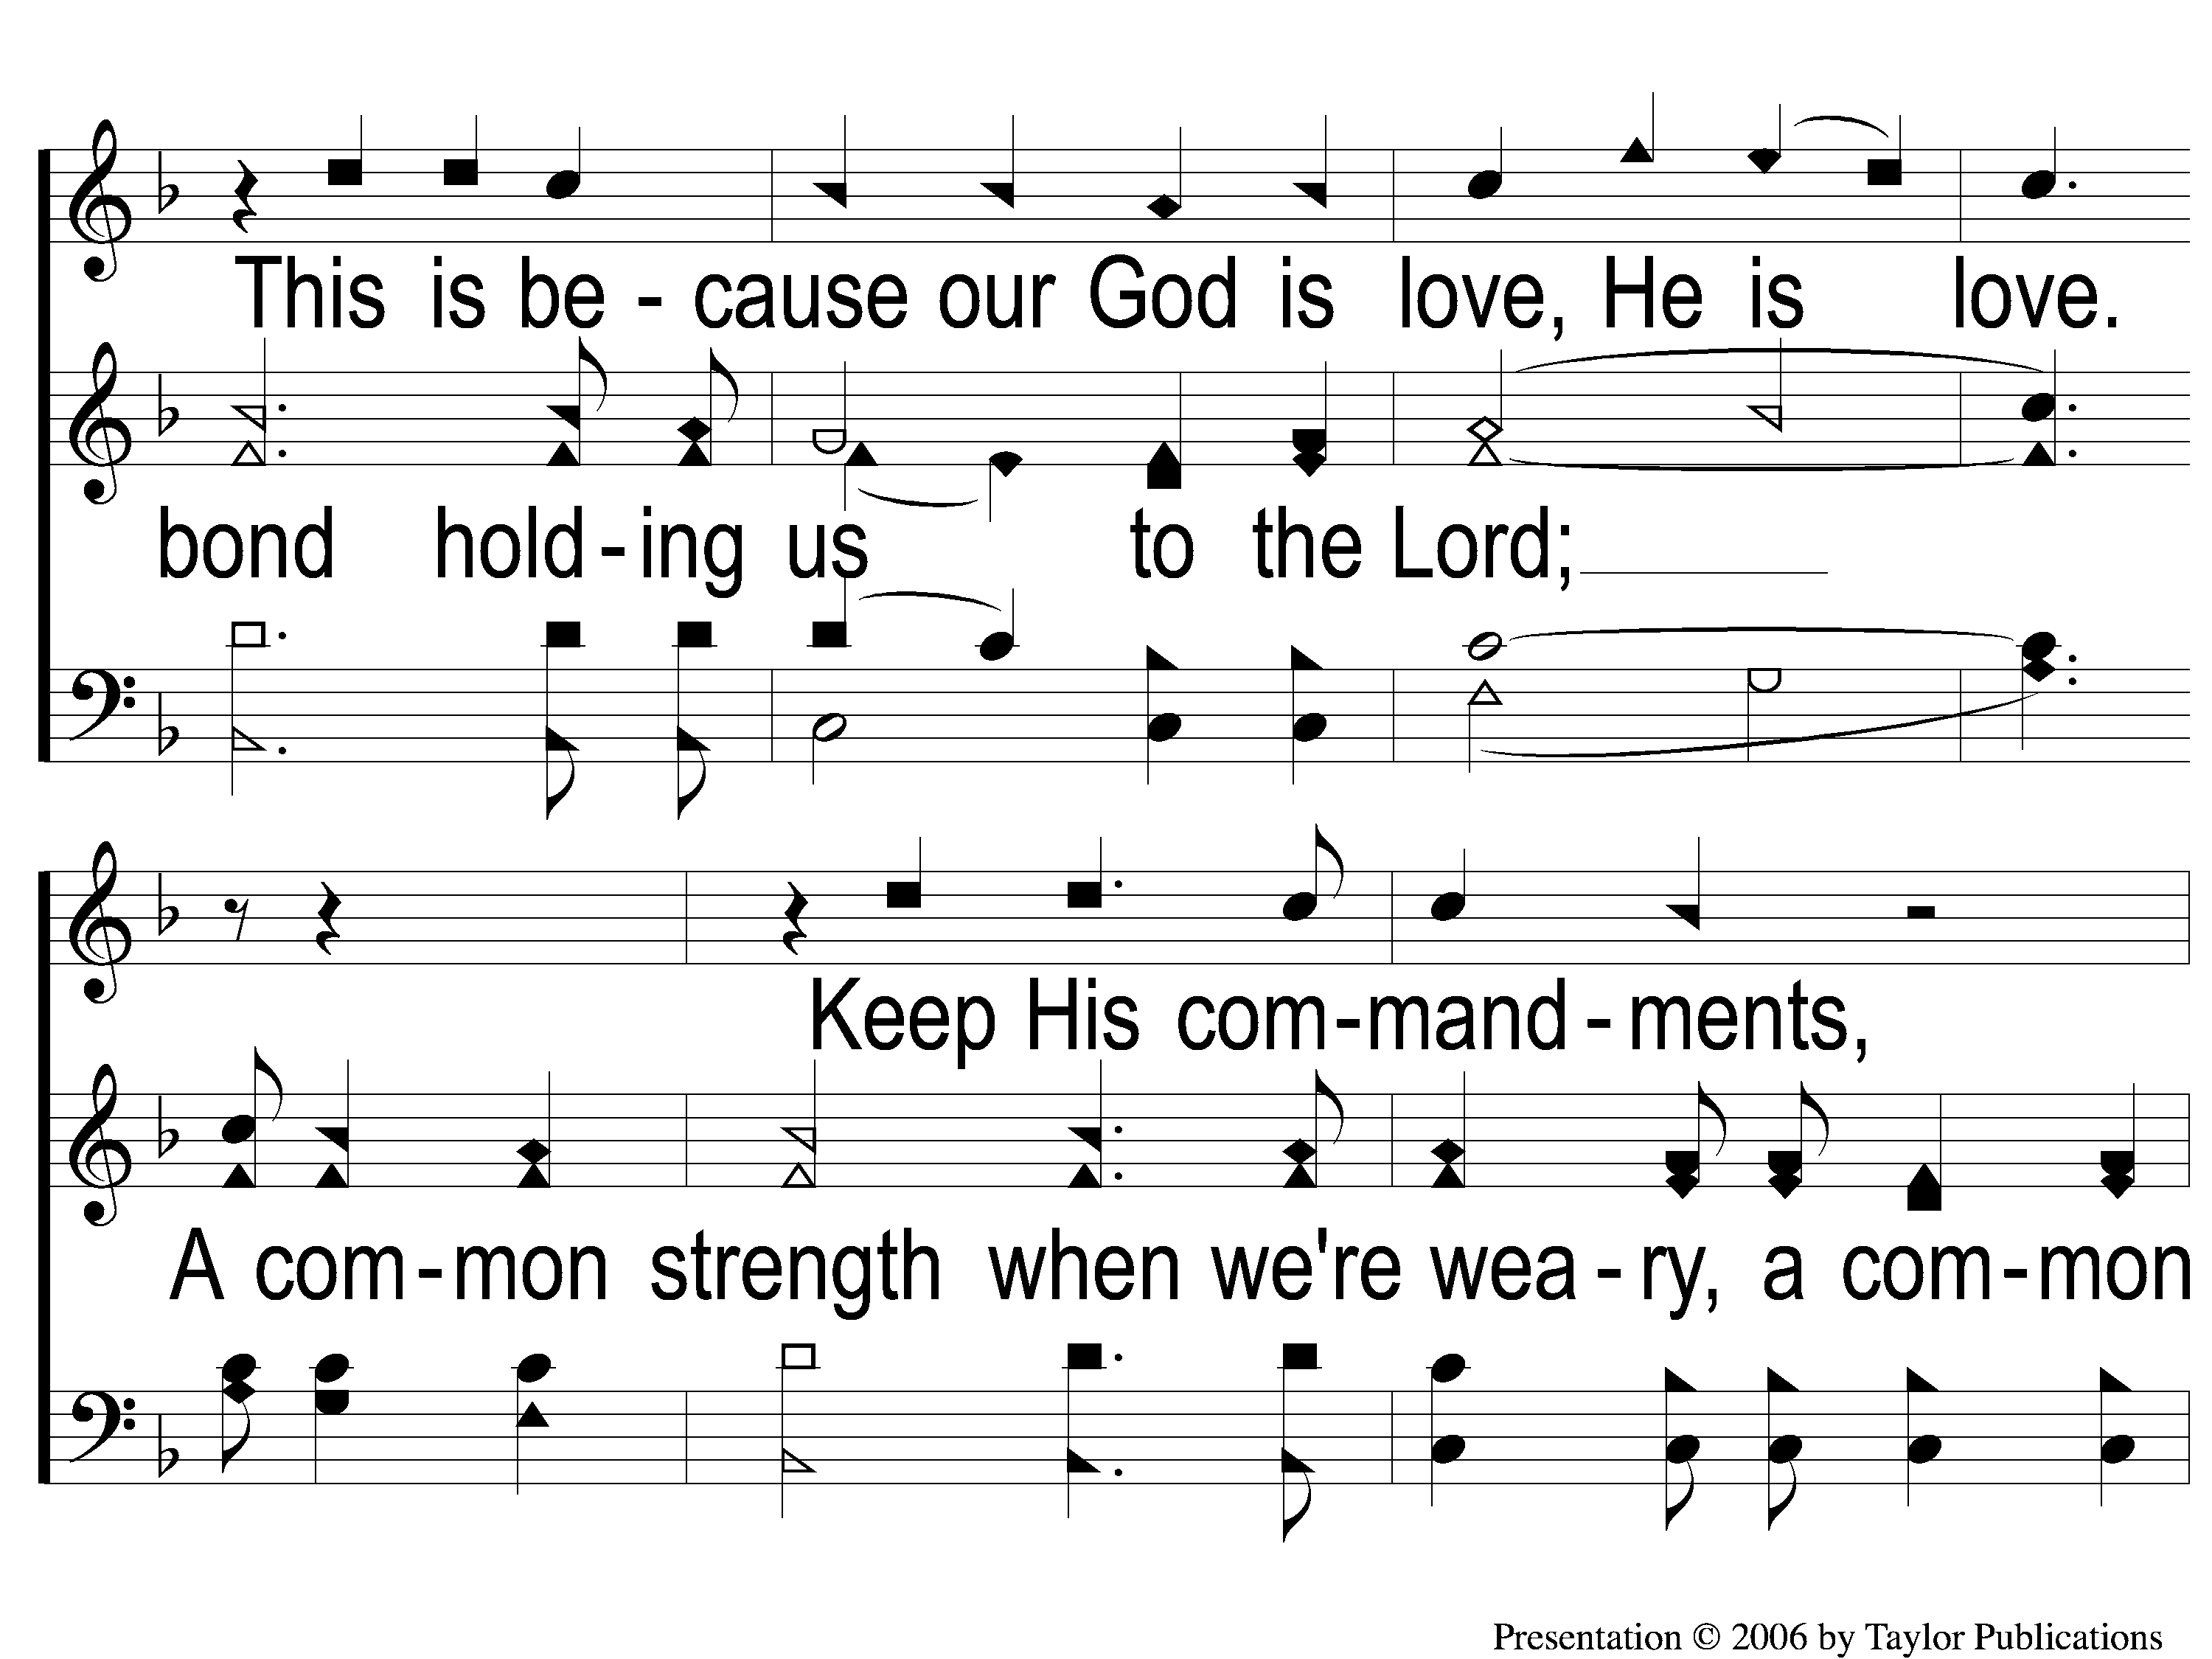
2 Opt descant A Common Love
A Common Love
705

Slide 6
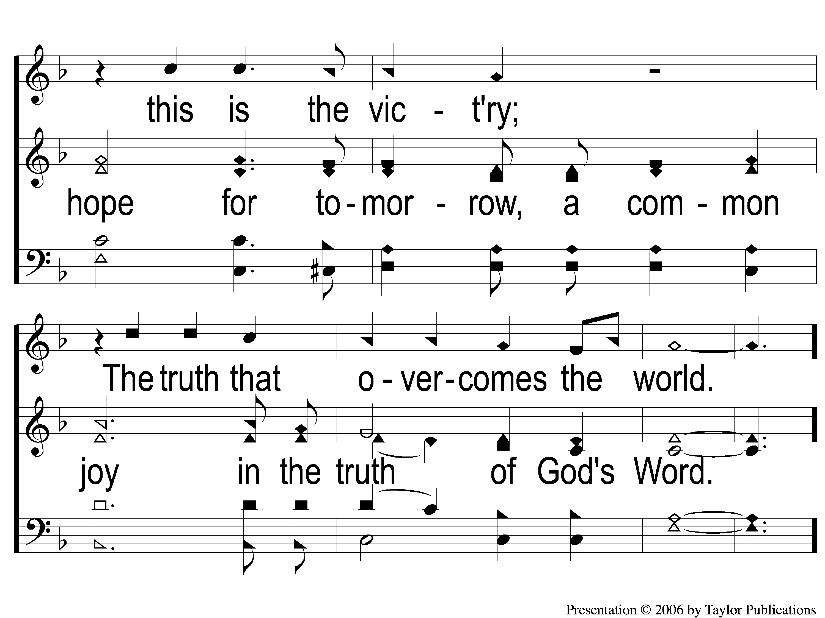
3 Opt descant A Common Love
A Common Love
705

